Slide 1
Artificial Intelligence Informed Search

Slide 2
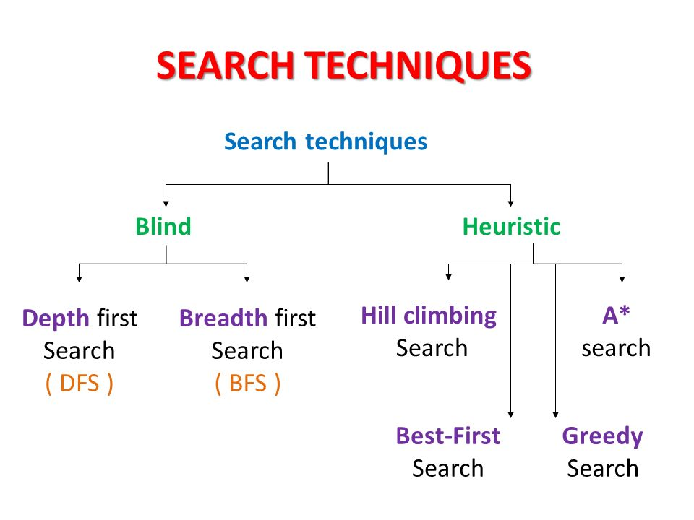
(uninformed Search)
(Informed Search)
Other blind search strategies are:
Depth-limited search (Extended DFS)
Iterative-deepening search (Extended DFS)
Uniform cost search
Bi-directional search

Slide 3
Uninformed Vs Informed Search
Uninformed search: Use only the information available in the problem definition. Example: breadth-first, depth-first, depth limited, iterative deepening, uniform cost and bidirectional search
Informed search: Use domain knowledge or heuristic to choose the best move. Example. Greedy best-first, A*, IDA*, and beam search

Slide 4
Using problem specific knowledge to aid searching
With knowledge, one can search the state space as if he was given “hints” when exploring a maze.
Heuristic information in search = Hints
Leads to dramatic speed up in efficiency.
A
B
C
D
E
Search only in this subtree!!
F
G
H
I
J
K
L
M
N
O

Slide 5
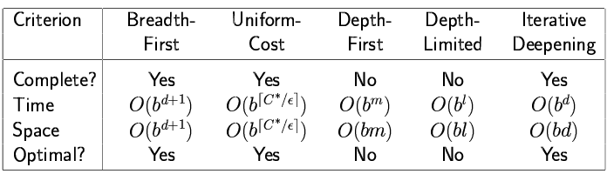
More formally, why heuristic functions work?
In any search problem where there are at most b choices at each node and a depth of d at the goal node, a naive search algorithm would have to, in the worst case, search around O(b^{d}) nodes before finding a solution (Exponential Time Complexity).
Heuristics improve the efficiency of search algorithms by reducing the effective branching factor from b to (ideally) a low constant b* such that
1 =< b* << b

Slide 6
Heuristic Functions
A heuristic function is a function f(n) that gives an estimation on the “cost” of getting from node n to the goal state – so that the node with the least cost among all possible choices can be selected for expansion first.
Three approaches to defining f:
f measures the value of the current state (its “goodness”)
f measures the estimated cost of getting to the goal from the current state:
f(n) = h(n) where h(n) = an estimate of the cost to get from n to a goal
f measures the estimated cost of getting to the goal state from the current state and the cost of the existing path to it. Often, in this case, we decompose f:
f(n) = g(n) + h(n) where g(n) = the cost to get to n (from initial state)

Slide 7
Approach 1: f Measures the Value of the Current State
Usually the case when solving optimization problems
Finding a state such that the value of the metric f is optimized
Often, in these cases, f could be a weighted sum of a set of component values:
N-Queens
Example: the number of queens under attack …
Data mining
Example: the “predictive-ness” (a.k.a. accuracy) of a rule discovered

Slide 8
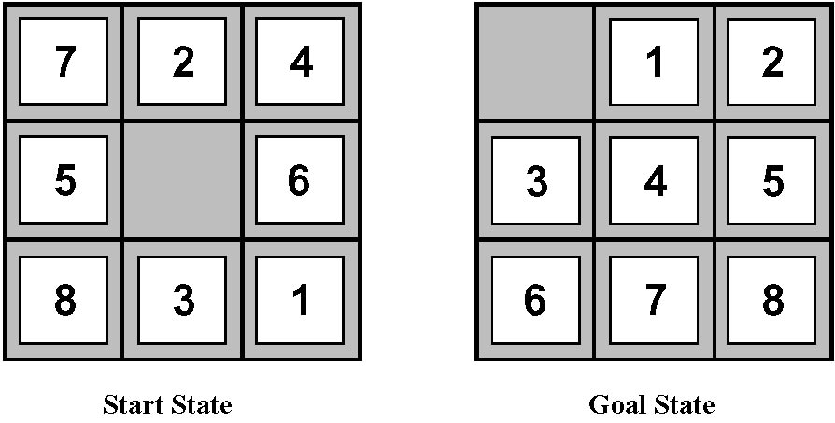
Approach 2: f Measures the Cost to the Goal
A state X would be better than a state Y if the estimated cost of getting from X to the goal is lower than that of Y – because X would be closer to the goal than Y
8–Puzzle
h₁: The number of misplaced tiles (squares with number).
h₂: The sum of the distances of the tiles from their goal positions.

Slide 9
Approach 3: f measures the total cost of the solution path (Admissible Heuristic Functions)
A heuristic function f(n) = g(n) + h(n) is admissible if h(n) never overestimates the cost to reach the goal.
Admissible heuristics are “optimistic”: “the cost is not that much …”
However, g(n) is the exact cost to reach node n from the initial state.
Therefore, f(n) never over-estimate the true cost to reach the goal state through node n.
Theorem: A search is optimal if h(n) is admissible.
I.e. The search using h(n) returns an optimal solution.
Given h₂(n) > h₁(n) for all n, it’s always more efficient to use h₂(n).
h₂ is more realistic than h₁ (more informed), though both are optimistic.

Slide 10
Traditional informed search strategies
Greedy Best first search
“Always chooses the successor node with the best f value” where f(n) = h(n)
We choose the one that is nearest to the final state among all possible choices
A* search
Best first search using an “admissible” heuristic function f that takes into account the current cost g
Always returns the optimal solution path

Slide 11
Informed Search Strategies
Best First Search

Slide 12
An implementation of Best First Search
function BEST-FIRST-SEARCH (problem, eval-fn)
returns a solution sequence, or failure
queuing-fn = a function that sorts nodes by eval-fn
return GENERIC-SEARCH (problem,queuing-fn)

Slide 13
Informed Search Strategies
Greedy Search
eval-fn: f(n) = h(n)

Slide 14
Greedy Search
Start
State | Heuristic: h(n)
A | 366
B | 374
C | 329
D | 244
E | 253
F | 178
G | 193
H | 98
I | 0
A
75
118
140
B
C
111
E
D
80
99
G
F
97
H
211
101
I
Goal
f(n) = h (n) = straight-line distance heuristic

Slide 15
Greedy Search
Start
State | Heuristic: h(n)
A | 366
B | 374
C | 329
D | 244
E | 253
F | 178
G | 193
H | 98
I | 0
A
75
118
140
B
C
111
E
D
80
99
G
F
97
H
211
101
I
Goal
f(n) = h (n) = straight-line distance heuristic

Slide 16
Greedy Search
Start
State | Heuristic: h(n)
A | 366
B | 374
C | 329
D | 244
E | 253
F | 178
G | 193
H | 98
I | 0
A
75
118
140
B
C
111
E
D
80
99
G
F
97
H
211
101
I
Goal
f(n) = h (n) = straight-line distance heuristic

Slide 17
Greedy Search
Start
State | Heuristic: h(n)
A | 366
B | 374
C | 329
D | 244
E | 253
F | 178
G | 193
H | 98
I | 0
A
75
118
140
B
C
111
E
D
80
99
G
F
97
H
211
101
I
Goal
f(n) = h (n) = straight-line distance heuristic

Slide 18
Greedy Search
Start
State | Heuristic: h(n)
A | 366
B | 374
C | 329
D | 244
E | 253
F | 178
G | 193
H | 98
I | 0
A
75
118
140
B
C
111
E
D
80
99
G
F
97
H
211
101
I
Goal
f(n) = h (n) = straight-line distance heuristic

Slide 19
Greedy Search
Start
State | Heuristic: h(n)
A | 366
B | 374
C | 329
D | 244
E | 253
F | 178
G | 193
H | 98
I | 0
A
75
118
140
B
C
111
E
D
80
99
G
F
97
H
211
101
I
Goal
f(n) = h (n) = straight-line distance heuristic

Slide 20
Greedy Search
Start
State | Heuristic: h(n)
A | 366
B | 374
C | 329
D | 244
E | 253
F | 178
G | 193
H | 98
I | 0
A
75
118
140
B
C
111
E
D
80
99
G
F
97
H
211
101
I
Goal
f(n) = h (n) = straight-line distance heuristic

Slide 21
Greedy Search
Start
State | Heuristic: h(n)
A | 366
B | 374
C | 329
D | 244
E | 253
F | 178
G | 193
H | 98
I | 0
A
75
118
140
B
C
111
E
D
80
99
G
F
97
H
211
101
I
Goal
f(n) = h (n) = straight-line distance heuristic

Slide 22
Greedy Search
Start
State | Heuristic: h(n)
A | 366
B | 374
C | 329
D | 244
E | 253
F | 178
G | 193
H | 98
I | 0
A
75
118
140
B
C
111
E
D
80
99
G
F
97
H
211
101
I
Goal
f(n) = h (n) = straight-line distance heuristic

Slide 23
Greedy Search
Start
State | Heuristic: h(n)
A | 366
B | 374
C | 329
D | 244
E | 253
F | 178
G | 193
H | 98
I | 0
A
75
118
140
B
C
111
E
D
80
99
G
F
97
H
211
101
I
Goal
f(n) = h (n) = straight-line distance heuristic

Slide 24
Greedy Search: Tree Search
Start
A

Slide 25
Greedy Search: Tree Search
Start
A
75
118
[329]
140
[374]
B
C
[253]
E

Slide 26
Greedy Search: Tree Search
Start
A
75
118
[329]
140
[374]
B
C
[253]
E
80
99
[193]
[178]
G
F
[366]
A

Slide 27
Greedy Search: Tree Search
Start
A
75
118
[329]
140
[374]
B
C
[253]
E
80
99
[193]
[178]
G
F
[366]
A
211
[253]
I
[0]
E
Goal

Slide 28
Greedy Search: Tree Search
Start
A
75
118
[329]
140
[374]
B
C
[253]
E
80
99
[193]
[178]
G
F
[366]
A
211
[253]
I
[0]
E
Goal
Path cost(A-E-F-I) = 253 + 178 + 0 = 431
dist(A-E-F-I) = 140 + 99 + 211 = 450

Slide 29
Greedy Search: Optimal ?
Start
State | Heuristic: h(n)
A | 366
B | 374
C | 329
D | 244
E | 253
F | 178
G | 193
H | 98
I | 0
A
75
118
140
B
C
111
E
D
80
99
G
F
97
H
211
101
I
Goal
f(n) = h (n) = straight-line distance heuristic
dist(A-E-G-H-I) =140+80+97+101=418

Slide 30
Greedy Search: Complete ?
Start
State | Heuristic: h(n)
A | 366
B | 374
** C | 250
D | 244
E | 253
F | 178
G | 193
H | 98
I | 0
A
75
118
140
B
C
111
E
D
80
99
G
F
97
H
211
101
I
Goal
f(n) = h (n) = straight-line distance heuristic

Slide 31
Greedy Search: Tree Search
Start
A

Slide 32
Greedy Search: Tree Search
Start
A
75
118
[250]
140
[374]
B
C
[253]
E

Slide 33
Greedy Search: Tree Search
Start
A
75
118
[250]
140
[374]
B
C
[253]
E
111
[244]
D

Slide 34
Greedy Search: Tree Search
Start
A
75
118
[250]
140
[374]
B
C
[253]
E
111
[244]
D
Infinite Branch !
[250]
C

Slide 35
Greedy Search: Tree Search
Start
A
75
118
[250]
140
[374]
B
C
[253]
E
111
[244]
D
Infinite Branch !
[250]
C
[244]
D

Slide 36
Greedy Search: Tree Search
Start
A
75
118
[250]
140
[374]
B
C
[253]
E
111
[244]
D
Infinite Branch !
[250]
C
[244]
D

Slide 37
Greedy Search: Time and Space Complexity ?
Start
A
75
Greedy search is not optimal.
Greedy search is incomplete without systematic checking of repeated states.
In the worst case, the Time and Space Complexity of Greedy Search are both O(b^{m})
Where b is the branching factor and m the maximum path length
118
140
B
C
111
E
D
80
99
G
F
97
H
211
101
I
Goal

Slide 38
Informed Search Strategies
A* Search
eval-fn: f(n)=g(n)+h(n)

Slide 39
A* (A Star)
Greedy Search minimizes a heuristic h(n) which is an estimated cost from a node n to the goal state. Greedy Search is efficient but it is not optimal nor complete.
Uniform Cost Search minimizes the cost g(n) from the initial state to n. UCS is optimal and complete but not efficient.
New Strategy: Combine Greedy Search and UCS to get an efficient algorithm which is complete and optimal.

Slide 40
A* (A Star)
A* uses a heuristic function which combines g(n) and h(n): f(n) = g(n) + h(n)
g(n) is the exact cost to reach node n from the initial state.
h(n) is an estimation of the remaining cost to reach the goal.

Slide 41
A* (A Star)
g(n)
f(n) = g(n)+h(n)
n
h(n)

Slide 42
A* Search
Start
State | Heuristic: h(n)
A | 366
B | 374
C | 329
D | 244
E | 253
F | 178
G | 193
H | 98
I | 0
A
75
118
140
B
C
111
E
D
80
99
G
F
97
H
211
101
I
f(n) = g(n) + h (n)
g(n): is the exact cost to reach node n from the initial state.
Goal

Slide 43
A* Search: Tree Search
A
Start

Slide 44
A* Search: Tree Search
A
Start
118
75
140
E
[393]
B
[449]
[447]
C

Slide 45
A* Search: Tree Search
A
Start
118
75
140
E
[393]
B
[449]
[447]
C
80
99
[413]
G
F
[417]

Slide 46
A* Search: Tree Search
A
Start
118
75
140
E
[393]
B
[449]
[447]
C
80
99
[413]
G
F
[417]
97
[415]
H

Slide 47
A* Search: Tree Search
A
Start
118
75
140
E
[393]
B
[449]
[447]
C
80
99
[413]
G
F
[417]
97
[415]
H
101
I
[418]
Goal

Slide 48
A* Search: Tree Search
A
Start
118
75
140
E
[393]
B
[449]
[447]
C
80
99
[413]
G
F
[417]
97
[415]
H
I
[450]
101
I
[418]
Goal

Slide 49
A* Search: Tree Search
A
Start
118
75
140
E
[393]
B
[449]
[447]
C
80
99
[413]
G
F
[417]
97
[415]
H
I
[450]
101
I
[418]
Goal

Slide 50
A* Search: Tree Search
A
Start
118
75
140
E
[393]
B
[449]
[447]
C
80
99
[413]
G
F
[417]
97
[415]
H
I
[450]
101
I
[418]
Goal

Slide 51
A* with f() not Admissible
h() overestimates the cost to reach the goal state

Slide 52
A* Search: h not admissible !
Start
State | Heuristic: h(n)
A | 366
B | 374
C | 329
D | 244
E | 253
F | 178
G | 193
H | 138
I | 0
A
75
118
140
B
C
111
E
D
80
99
G
F
97
H
211
101
I
f(n) = g(n) + h (n) – (H-I) Overestimated
g(n): is the exact cost to reach node n from the initial state.
Goal

Slide 53
A* Search: Tree Search
A
Start

Slide 54
A* Search: Tree Search
A
Start
118
75
140
E
[393]
B
[449]
[447]
C

Slide 55
A* Search: Tree Search
A
Start
118
75
140
E
[393]
B
[449]
[447]
C
80
99
[413]
G
F
[417]

Slide 56
A* Search: Tree Search
A
Start
118
75
140
E
[393]
B
[449]
[447]
C
80
99
[413]
G
F
[417]
97
[455]
H

Slide 57
A* Search: Tree Search
A
Start
118
75
140
E
[393]
B
[449]
[447]
C
80
99
[413]
G
F
[417]
97
[455]
Goal
H
I
[450]

Slide 58
A* Search: Tree Search
A
Start
118
75
140
E
[393]
B
[449]
[447]
C
80
99
[473]
[413]
G
F
[417]
D
97
[455]
Goal
H
I
[450]

Slide 59
A* Search: Tree Search
A
Start
118
75
140
E
[393]
B
[449]
[447]
C
80
99
[473]
[413]
G
F
[417]
D
97
[455]
Goal
H
I
[450]

Slide 60
A* Search: Tree Search
A
Start
118
75
140
E
[393]
B
[449]
[447]
C
80
99
[473]
[413]
G
F
[417]
D
97
[455]
Goal
H
I
[450]

Slide 61
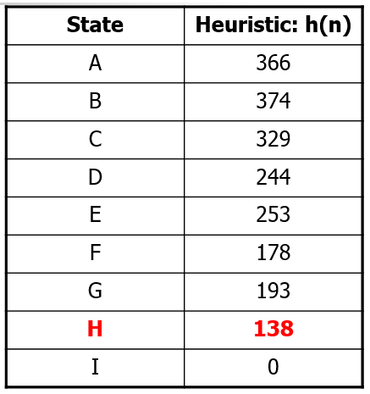
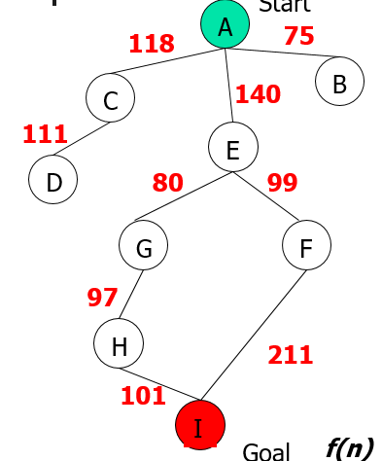
A* Search: Tree Search
A
Start
118
75
140
E
[393]
B
[449]
[447]
C
80
99
[473]
[413]
G
F
[417]
D
97
[455]
Goal
H
I
[450]
A* not optimal !!!

Slide 62
A* Algorithm
A* with systematic checking for repeated states …

Slide 63
A* Algorithm
1. Search queue Q is empty.
2. Place the start state s in Q with f value h(s).
3. If Q is empty, return failure.
4. Take node n from Q with lowest f value.
(Keep Q sorted by f values and pick the first element).
5. If n is a goal node, stop and return solution.
6. Generate successors of node n.
7. For each successor n’ of n do:
a) Compute f(n’) = g(n) + cost(n,n’) + h(n’).
b) If n’ is new (never generated before), add n’ to Q.
c) If node n’ is already in Q with a higher f value, replace it with current f(n’) and place it in sorted order in Q.
End for
8. Go back to step 3.

Slide 64
A* Search: Analysis
A* is complete except if there is an infinity of nodes with f < f(G).
A* is optimal if heuristic h is admissible.
Time complexity depends on the quality of heuristic but is still exponential.
For space complexity, A* keeps all nodes in memory. A* has worst case O(b^{d}) space complexity, but an iterative deepening version is possible (IDA*).
Start
A
75
118
140
B
C
111
E
D
80
99
G
F
97
H
211
101
I
Goal

Slide 65
Informed Search Strategies
Iterative Deepening A*

Slide 66
Iterative Deepening A*:IDA*
Use f(N) = g(N) + h(N) with admissible and consistent h
Each iteration is depth-first with cutoff on the value of f of expanded nodes

Slide 67
Consistent Heuristic
The admissible heuristic h is consistent (or satisfies the monotone restriction) if for every node N and every successor N’ of N: h(N) ≤ c(N,N’) + h(N’) (triangular inequality)
A consistent heuristic is admissible.
N
c(N,N’)
N’
h(N)
h(N’)

Slide 68
IDA* Algorithm
In the first iteration, we determine a “f-cost limit” – cut-off value f(n₀) = g(n₀) + h(n₀) = h(n₀), where n₀ is the start node.
We expand nodes using the depth-first algorithm and backtrack whenever f(n) for an expanded node n exceeds the cut-off value.
If this search does not succeed, determine the lowest f-value among the nodes that were visited but not expanded.
Use this f-value as the new limit value – cut-off value and do another depth-first search.
Repeat this procedure until a goal node is found.

Slide 69
8-Puzzle
f(N) = g(N) + h(N)
with h(N) = number of misplaced tiles
4
Cutoff=4
6

Slide 70
8-Puzzle
f(N) = g(N) + h(N)
with h(N) = number of misplaced tiles
4
Cutoff=4
4
6
6

Slide 71
8-Puzzle
f(N) = g(N) + h(N)
with h(N) = number of misplaced tiles
4
Cutoff=4
4
5
6
6

Slide 72
8-Puzzle
f(N) = g(N) + h(N)
with h(N) = number of misplaced tiles
5
4
Cutoff=4
4
5
6
6

Slide 73
8-Puzzle
f(N) = g(N) + h(N)
with h(N) = number of misplaced tiles
6
5
4
Cutoff=4
4
5
6
6

Slide 74
8-Puzzle
f(N) = g(N) + h(N)
with h(N) = number of misplaced tiles
4
Cutoff=5
6

Slide 75
8-Puzzle
f(N) = g(N) + h(N)
with h(N) = number of misplaced tiles
4
Cutoff=5
4
6
6

Slide 76
8-Puzzle
f(N) = g(N) + h(N)
with h(N) = number of misplaced tiles
4
Cutoff=5
4
5
6
6

Slide 77
8-Puzzle
f(N) = g(N) + h(N)
with h(N) = number of misplaced tiles
4
Cutoff=5
4
5
7
6
6

Slide 78
8-Puzzle
f(N) = g(N) + h(N)
with h(N) = number of misplaced tiles
4
5
Cutoff=5
4
5
7
6
6

Slide 79
8-Puzzle
f(N) = g(N) + h(N)
with h(N) = number of misplaced tiles
4
5
5
Cutoff=5
4
5
7
6
6

Slide 80
8-Puzzle
f(N) = g(N) + h(N)
with h(N) = number of misplaced tiles
4
5
5
Cutoff=5
4
5
7
6
6

Slide 81
When to Use Search Techniques
The search space is small, and
There are no other available techniques, or
It is not worth the effort to develop a more efficient technique
The search space is large, and
There is no other available techniques, and
There exist “good” heuristics

Slide 82
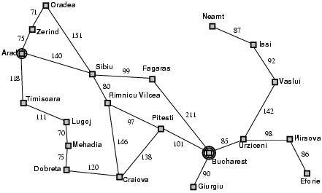
Popular AI Search Problems
Classic AI search problems, Map searching (navigation)

Slide 83
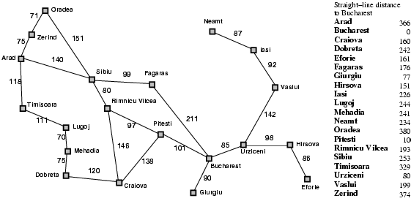
Romania with step costs in km

Slide 84
A* search
Idea: avoid expanding paths that are already expensive
Evaluation function f(n) = g(n) + h(n)
g(n) = cost so far to reach n
h(n) = estimated cost from n to goal
f(n) = estimated total cost of path through n to goal

Slide 85

A* search example

Slide 86
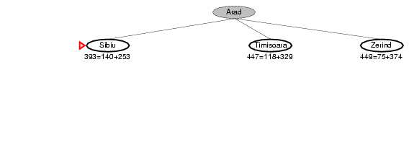
A* search example

Slide 87
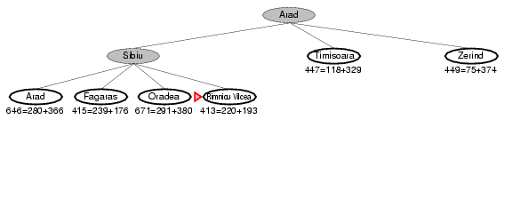
A* search example

Slide 88
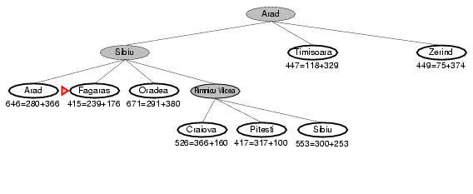
A* search example

Slide 89
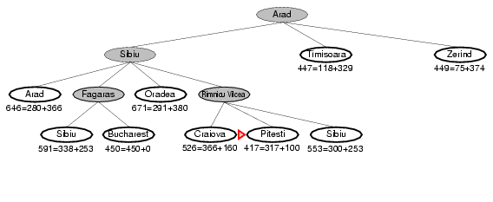
A* search example

Slide 90
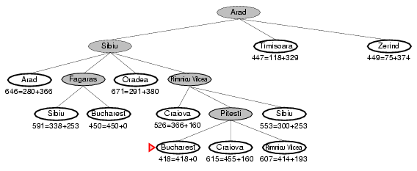
A* search example

Slide 91
Admissible heuristics
A heuristic h(n) is admissible if for every node n,
h(n) ≤ h*(n), where h*(n) is the true cost to reach the goal state from n.
An admissible heuristic never overestimates the cost to reach the goal, i.e., it is optimistic
Example: h_{SLD}(n) (never overestimates the actual road distance)
Theorem: If h(n) is admissible, A* using TREE-SEARCH is optimal

Slide 92
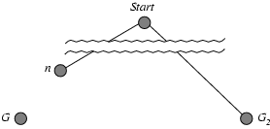
Optimality of A* (proof)
Suppose some suboptimal goal G₂ has been generated and is in the fringe. Let n be an unexpanded node in the fringe such that n is on a shortest path to an optimal goal G.
f(n)=g(n)+h(n)
f(G₂) = g(G₂) + h(G₂)
f(G₂) = g(G₂) [since h(G₂) = 0] ……….(1)
Again, f(G) = g(G) + h(G)
f(G) = g(G) [since h(G) = 0] …………(2)
But, g(G₂) > g(G) [since G₂ is suboptimal]…….(3)
Therefore, f(G₂) > f(G) [ from equation (1), (2) and (3)] ……. (4)

Slide 93
Optimality of A* (proof)
Suppose some suboptimal goal G₂ has been generated and is in the fringe. Let n be an unexpanded node in the fringe such that n is on a shortest path to an optimal goal G.
Therefore, f(G₂) > f(G) ……. (4) [ from equation (1), (2) and (3)]
Again, h(n)≤ h*(n) …………….(5) [since h is admissible; Here, h*(n) is the true cost to reach the goal state from n]
g(n) + h(n)≤ g(n) + h*(n) ……. (6) [ Adding g(n) in both sides of equation (5)]
f(n) ≤ f(G) …… (7) [Because, f(n)= g(n) + h(n) ; and f(G) = g(n) + h*(n); Here, h*(n) is the true cost to reach the goal state from n] f(n) ≤ f(G) < f(G₂) [From equation (4) and (7)]
Therefore, f(G₂) > f(n), and A* will never select G₂ for expansion before expanding n to reach at optimal goal G.

Slide 94
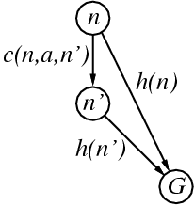
Consistent heuristics
A heuristic is consistent if for every node n, every successor n' of n generated by any action a, follows the triangular inequality.
h(n) ≤ c(n,a,n') + h(n')
If h is consistent, we have
f(n') = g(n') + h(n')
= g(n) + c(n,a,n') + h(n')
≥ g(n) + h(n)
= f(n)
i.e., f(n) is non-decreasing along any path.
Theorem: If h(n) is consistent, A* using GRAPH-SEARCH is optimal

Slide 95
Properties of A*
Complete? Yes (unless there are infinitely many nodes with f ≤ f(G) )
Time? Depends on the quality of heuristic but still exponential.
Space? Keeps all nodes in memory. A* has worst case O(b^{d}) space complexity
Optimal? Yes

Slide 96
Local beam search
Keep track of k states rather than just one
Start with k randomly generated states
At each iteration, all the successors of all k states are generated
If any one is a goal state, stop; else select the k best successors from the complete list and repeat.

Slide 97
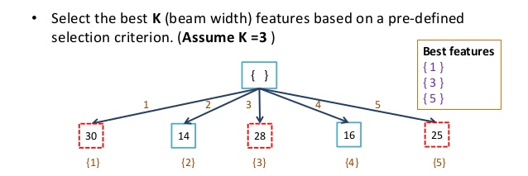
Local Beam Search
Begin with k random states
Generate all successors of these states
Keep the k best states
Stochastic beam search: Probability of keeping a state is a function of its heuristic value

Slide 98
Conclusions
Frustration with uninformed search led to the idea of using domain specific knowledge in a search so that one can intelligently explore only the relevant part of the search space that has a good chance of containing the goal state. These new techniques are called informed (heuristic) search strategies.
Even though heuristics improve the performance of informed search algorithms, they are still time consuming especially for large size instances.

Slide 99
References
University of Berkeley, USA
http://www.aima.cs.berkeley.edu

